Slide 1


BUDGET PRESENTATION
Society of Automotive Engineers- SVNIT Chapter

Slide 2
Allocated Budget Supra 2015
Budget Amount Sanctioned- Rs 5,30,874/-
Advance was taken in 3 steps
Rs 5,30,874/-
1st advance Rs 1,94,233/-
Settled for Rs 1,57,619/-
Rs 36,614 was refunded
2nd advance Rs 2,67,225/-
Settled for Rs 2,38,065/-
Rs 29,616/- was refunded
File submitted. Has not been cleared as of last update,
2nd advance Rs 1,32,000/-
Settled for Rs 99,852/-
Rs 32,148/- was refunded
File submitted. Has not been cleared as of last update,
Total balance of Chapter account is Rs 32,148/- after final settlement of account.

Slide 3
Chapter Activities 2014-15
Members of the chapter participated in the National Go- Kart Championship 2014
Held 2nd position in Preliminary Design Competition
Overall rank 30th out of 102 teams who qualified for the main competition held at Coimbatore from 17th to 19th October 2014
Members participated in Student Formula 2015 (SUPRA 2015) organised by SAE INDIA.
Qualified preliminary round with 42th rank out of 167 teams.
Finished 78th out of 110 teams at final competition, vehicle was made inoperable on site due to suspension failure.
Organised Design seminar in February 2015 for 1st and 2nd year
Project on study of flow through intake Manifold with investigation into Helmholtz resonance and optimisation of flow through restrictor.
Introduction of fibreglass. In house development of fibreglass parts for the first time.
Study and incorporation of pull rod suspension into the Phoenix vehicle series
Project on Data acquisition system for induction in Phoenix Vehicle. Data includes Speed, Engine RPM, GPS position, Gear shift indication and the transmission of data to remote Laptop for real time analysis

Slide 4
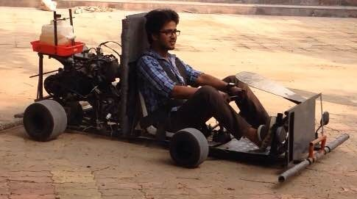
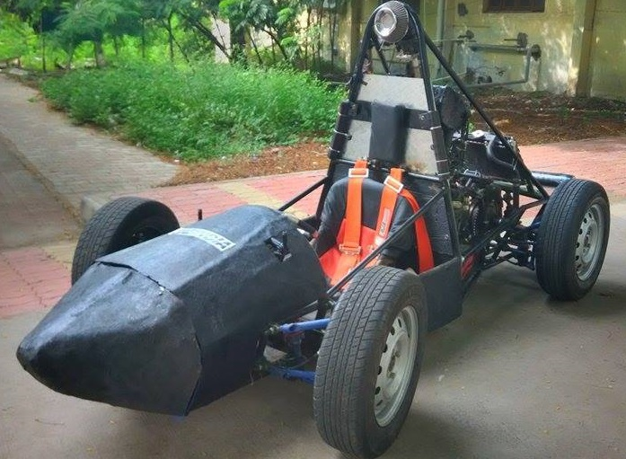
Chapter Activities 2014-15
Phoenix 2014
Phoenix 2015

Slide 5
Chapter Activities 2015-16
Participation in Supra SAE Collegiate competition. Preliminary round - October 2015 (Tentative). Final Round- July 2016 (Tentative)
Rs 690420/-
Upgradation of manufacturing facilities and refurnishing of tools-
Rs 21,277/-
Organising event for remote controlled small IC Engine powered vehicle. Tentative time-November 2015. Proposal to keep the same as an intercollegiate competition as a part of Sparsh 2016.
(Costs include prototype making from the chapter and organisational costs for track making and prizes) Rs 30,000/-
Lectures to be organised on Automotive Design and use of CAE.
Program on manufacturing theory and practical. Will include Welding shop, Machine shop and finishing.
Open discussion forums to be organised on topics related to mobility industry to increase interest and level of technical knowledge

Slide 6
Chapter Activities 2015-16
Increase scope of project work. Further new year long studies and projects are proposed, namely-
Thermal analysis and design of brake system
(Study and computer analysis)
Acoustic analysis of automotive Exhaust to decrease back pressure for given road noise level standards
(Study, computer analysis and prototype development) Rs 10,000/-
Increasing welding rate by controlling arc shape using cross magnetic field to elliptical shape.
(Computer Analysis and experimentation if possible) Rs 30,000/-
Use of exhaust gas to drive cooling system (VAS cycle) for intercooler for forced induction engines.
(Study and Analysis)
Introduction of alternative materials and their induction to Phoenix vehicle series. (Includes further development of fibreglass to load bearing structures, introduction of aluminium)
(Skill development and prototype making for dies for fibreglass) Rs 10,000/-
Feasibility study for in house development of high strength Aluminium Grade 7707.
(Feasibility Study) Rs 3000/- for 3Kg
Development of skill for incorporation of CAM through CNC machines to develop complicated parts.
(Skill development program) Rs 5000- for raw material Mild steel
Study and design of Intelligent braking system
(Feasibility study and prototype for small bot) Rs 15,000 /-
Total Budget Required- Rs7,85,896/-

Slide 7
Budget Analysis Projects
Exhaust Muffler Rs 10,000/- approx
Two designs will be proposed. Cost is per piece.
Piping Rs 2000/-
Glass wool Rs 825, (Rs 165/Kg)
Machining and pipe bending cost Rs 1500
Fasteners Cost- Rs 50 approx
Raw material Rs 300 (Rs 75 stainless steel sheets minimum order required)
Arc shape modification in welding Rs 30,000/-
Introduction to Alternative Materials Rs 10,000/- approx
Material for fibreglass
10 Kg Resin- Rs 2350 (Rs 235/Kg)
10 Kg Glass Fibre- Rs 1650 (Rs 165/Kg)
500g Hardener Rs 250 (Rs 50/100g)
500g Cobalt- Rs 300 (Rs60/100g)
Aluminium- Rs 3750 (Rs750/Kg)
Die material
Includes Cardboard, Wood, Wax and polythene roll Rs- 2000/-
Intelligent Braking System
Sads
asd

Slide 8
Budget Analysis Supra 2016
Sr No | Components | Details | Cost (Rs)
1 | Wheel Assemblies | Tyres and rims, Brake Assembly(Callipers, discs), hubs, uprights | 119980
2 | Chassis and Body Work | Steel Tubes, Welding Equipment, Brackets and mountings, moulds, Fibre Reinforced Polyester sheets etc | 92950
3 | Steering | Steering Rack, bearings, Column, tie rods, Steering wheel | 19000
4 | Suspension | Shock Absorbers, Springs, A Arms, Rod end bearings. | 41940
5 | Power train | Engine with gearbox, Bearings, Chain, Differential, Drive Shaft, Sprocket | 87500
6 | Registration | Competition Entry fee | 57100
7 | Electrical System | Custom boards, Engine management system, Wiring, harness, gauges and sensors | 30200
8 | Safety | Impact attenuator, Fire extinguishers, welding gear | 27850
9 | Testing | Fuel, repairs, upgrades | 13000
10 | Logistics | Accommodation of team, Transport of vehicle | 179900
11 | Sponsorship and Publicity | Printing, Display, Postage, Travelling | 8000
 |  | Total | 690420

Slide 9
Budget Analysis Supra 2016
Wheel End
Suspension
Dampers+spring | 4 | 20000
Bearings | 4 | 4000
Rod end bearings | 10mm X 24 + 20mm X 12 | 17940
Al knuckel
Al block 7075 23kg (40x20x20cm) | 2 | 34500
Machining |  | 10000
Engine
maintainance |  | 15000
Intake manifold | 1 | 10000
Manifold + engine accessories holding profile |  | 2000
Exhaust pipes+ machining |  | 5000
Muffler | 1 | 10000
Non burnaable titanium wrap | 1 | 1500
Throttle body (ALUMINIUM) | 1 | 5000
Radiator | 1 | 11000
Electricals and electronics
Wiring (wires, connectors, cable ties) |  | 5000
Electrical swithces |  | 2500
lcd 128x64 (blue & green) glcd | 1 | 1700
rotary encoder | 1 | 300
Hall effect sensor or comparator sensor | 1 | 1300
leds | 1 | 0
Gps module | 1 | 0
Im sensor or digital thermal sensor | 1 | 300
Voltage detection sensor | 1 | 300
flex sensor | 6 | 3000
ultrasonic sensor | 6 | 900
Stepper motors with microstepping drive | 1 | 2400
arduino mega 2560 | 1 | 1000
sd card module | 1 | 300
sd card module | 1 | 200
Combination meter | 1 | 11000
Chassis
Tubes (AISI1018) |  | 20000
Al Profile
Al block 7075 17kg (70x70x1.2cm) | 1 | 12750
Machining (CNC) |  | 8000
Bodywork+painting |  | 15000
Actuation System
Pedal box assembly (with master cylinder) | 1 | 15000
Gear cables with cover | 2 | 1000
Brake cables with cover | 2 | 200
Powertrain
alloy Rims | 4 | 14000
Differential | 1 | 14000
sprocket | 1 | 5000
Automotive chain | 1 | 3000
Axle | 2 | 6000
Hubs | 4 | 3000
Tyres (2 sets) | 8 | 38000
Brakes
Callipers (set of 4, maruti 800) | 4 | 12500
Disc | 4 | 3000
Brake pads(in case stock wore out in testing) | 4 | 3500
Brake lines | 4 | 680
brake oil | 1litre | 800
Steering
Steering wheel | 1 | 5500
Steering rack | 1 | 10000
Steering column | 1 | 1500
removable coupling | 1 | 2000

Slide 10
Budget Analysis Supra 2016
Fastners |  | 6000
Welding |  | 15000
Machinaries
Bench grinder | 1 | 3850
Hand drill | 1 | 6450
Tools
Pnuematic vane torque gun | 1 | 2592
Air nozzle gun | 1 | 2250
Universal screw driver set | 1 | 350
Tool boxes | 2 | 800
Electric torque wrench | 1 | 0
Measuring tools
Vernier calliper | 2 | 790
Measuring tape | 2 | 90
Weighing scale | 1 | 1105
Existing tools repairing |  | 3000
Previous vehicles repair ,maintaince and paintjob |  | 10000
Logistics |  | 90000
Traveling & accomodation
Train tickets (rate card attached) | 5+25 | 39900
Accomodation | 25 | 50000
miscellaneous |  | 8000
Petrol | 84litres | 6000
Projects + workshops + events |  | 75000
Publicity
Stickers |  | 600
Banners |  | 500
Broucher |  | 2000
Posters |  | 150
Visiting cards |  | 100
Website management
.org domain | 1 | 249
Hosting a website | 1 | 6000
Safety Equipments
Impact attuenator | 1 | 25000
Welding shield | 1 | 550
Welding glows | 2 | 500
First aid kit | 1 | 500
Fire extinguishers refilling | 6kg | 1800
Event registeration 1st round |  | 17200
2nd round |  | 39000
Total |  | 785896

